Slide 1

GTPL
17th Dec 2008
Confidential | Copyright © Larsen & Toubro Infotech Ltd.
Confidential | Copyright © Larsen & Toubro Infotech Ltd.

Slide 2
Contents
1
Background / Legacy Systems
2
Desired State
3
Overview/Quick Facts
4
  Transaction & Reporting DB
5
BA Role in GTPL
Confidential | Copyright © Larsen & Toubro Infotech Ltd.

Slide 3
GTPL : Background Summary
The charter of the P&L consolidation effort is to achieve the CIB Finance division’s goal for a single cash products P&L processor that supports the current and foreseeable needs of the business.
Business drivers
Vision
Business Growth
Cost Efficiencies
Risk Mitigation
Improved Controls
Common Global Processing
Multi-entity & Multi-currency
Multi-region & Multi-cash products
Efficient daily and monthly processing
Global platform / Regional processing
Centralized Control Environment
The legacy environment did not support the vision.
Confidential | Copyright © Larsen & Toubro Infotech Ltd.

Slide 4
GTPL – Legacy systems
Existing Business Systems
ETPL (Economic Trading Profit & Loss)
All cash products for Institutional clients (Legacy Salomon Brothers)
TMS (Trades Management System)
All cash products for Institutional & Retail clients (Legacy Smith Barney)
CTS (Citibank Trading System)
Fixed income products, Exchange traded options for Institutional clients ((Legacy Citibank)
EDS (Equity Derivatives System)
Equities & Exchange traded options (Legacy Citibank)
Prior state
Deficiencies
Multiple and limited product processors and sources with non-standardized data
Costly legacy systems
Manual P&L adjustments
Non-standard interest allocation processes
Disparate profit & loss reporting
Global but non-regional processing
Limited ability to accommodate increasing volumes
Inflexible accounting methodology in handling complex securities and products
Increased risk exposure and cost
Decentralized reporting
Lack of multi-entity/currency capability
Limited interest control and allocation capabilities
Need for a fully integrated Global Trade Profit and Loss application that will replace the suite of complex, and SME dependent applications presently being used within the firm.
Confidential | Copyright © Larsen & Toubro Infotech Ltd.

Slide 5
GTPL – Desired State Summary
Global Trading Profit and Loss system for Citibank and CGM
Consolidated current P&L system’s functionality with new features
Improved and efficient processes for P&L calculation and reporting
Phase-out current P&L systems and other redundant systems
Global, Regional P&L processing with consolidated P&L reporting
Ability to handle increasing business growth
Scalable for future enhancements and modifications.
A cost effective solution to replace the existing costly legacy P&L systems
Confidential | Copyright © Larsen & Toubro Infotech Ltd.

Slide 6
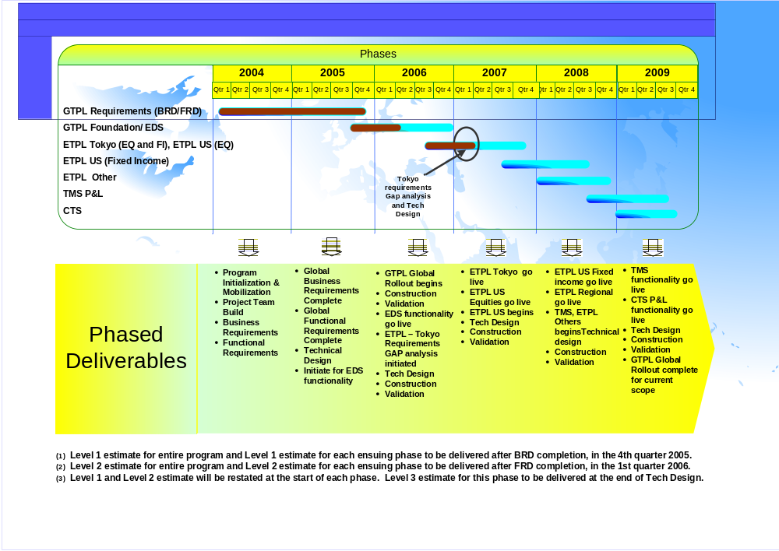
GTPL Program Management – Project Management
GTPL Phasing Strategy

Slide 7
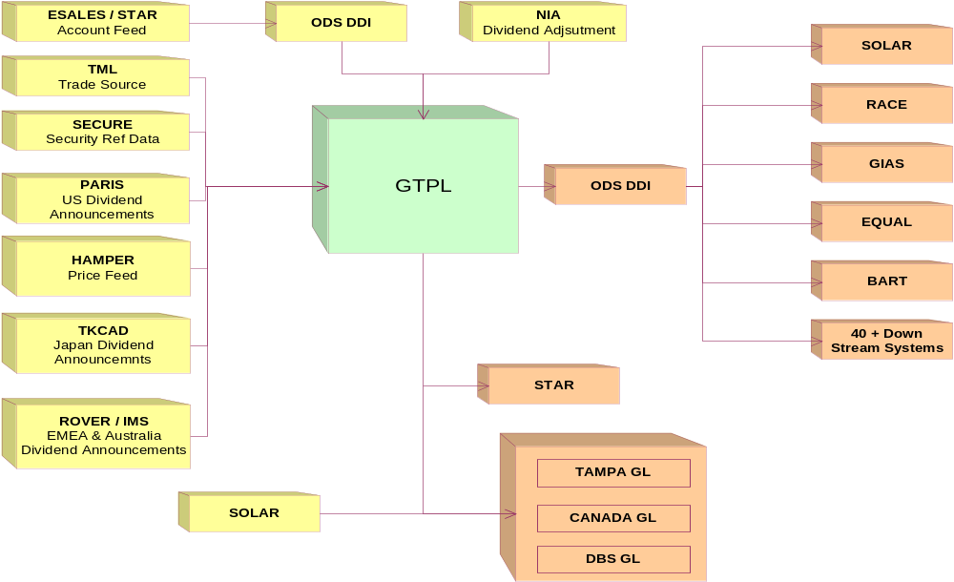
GTPL- snapshot

Slide 8
GTPL Overview
Reference
Data
Acquisition &
Cleansing
Front Office
EQRMS / EDS
COLT
ZEUS
GFI TPS
TES
Transaction Management Layer
Compression
Transformation
Validation
Enrichment
Sequencing
Fx Rates
Example: Hamper
DDI
Risk & Compliance
Future Reference Data Initiatives
GCR
Credit Engine (Trades)
Trade Processing
P&L Process
NIA Adjustments
Holiday Calendar
Accrual Process
Manual (GUI) Adjustments
Corporate Action Processing
Fixed Income Processing
Interest Control
Firm Accounts
(E-sales)
MTM Process
Entitlements
DDI
GIAS (Position)
NIA (Dividends)
NIA (Trade)
Prices
Example: Hamper
LTD
FX P&L
Posting Process
Products
Example: Secure
DLY
MTD
Func CCY Translation
Reporting & Other
QTD
YTD
USD Translation
SOLAR (Position)
SOLAR (Security)
STAR (Trades)
FDS (Trades)
Corporate Actions Data
Example:
PARIS Feed
Common Utilities/Shared Services
Ledger
Users
ESF
ELF
Business Works
AbInitio
TAMPA GL
Canada GL
Product Control
Interest Control
Business Activity Monitoring
(BAM)
Reconciliation
(Smartstream)
Weblogic
EMS
DBS
Fin. ASKA
Operations
P&L Admin
Active GICAP Projects
Proposed Future GICAP Projects
Non GICAP projects that are key dependencies
Confidential | Copyright © Larsen & Toubro Infotech Ltd.

Slide 9
GTPL – Project Scope
In Scope
  The following packages are in scope for the project.
  Historical data migration from existing four P&L Systems
  Phasing-out current P&L systems
  System dependency identification and current business process improvement
  Trade Events
  Profit and Loss
  GL Posting
  Adjustments
  Aging
  Accruals
  Reconciliation
  Monitoring
  Commissions
  Closing/Calendar
  Corporate Actions
  Pricing & FX Rates
  Position Distribution
  Reporting
  Security and Entitlements
Out Of Scope
  Building reference data solution for GTPL
  Any changes to external systems interacting with GTPL.
Confidential | Copyright © Larsen & Toubro Infotech Ltd.

Slide 10
GTPL – Key Upstream Systems and Consumption of Data
Key Upstream System | Data Input | GTPL Table
Trade Middle Layer (TML) | Trades | Trade tables
HAMPER for Prices | Prices | Price tables
PARIS/TKCAD | Dividend | Dividend tables
SECURE | Security Information | Security tables
ESALES | Account Information | Account tables
Confidential | Copyright © Larsen & Toubro Infotech Ltd.

Slide 11
Transactional & Reporting Databases
WHY ??
Transactional Database is maintained to consume data into GTPL, process it (per business rules) and save the processed information and make adjustments to it if required
Reporting Database is maintained as an OUTBOX to store the processed data output of GTPL
  No processing happens on the Reporting Database
  Data is sent to the down stream systems (clients of GTPL) from the Reporting Database
  Downstream systems either get a feed file from Reporting Database or access and copy the required information from the Reporting Database
  The Transactional Database is generally shielded from the downstream systems
  Transactional database is visible only to Product Control to view or pass adjustment entries
This explains the maintenance of two separate databases.
Confidential | Copyright © Larsen & Toubro Infotech Ltd.

Slide 12
  Business Analyst in GTPL
Roles
  The Business Analyst ensures that there is a systematic approach to the capture of Business Requirements (needs and features) and the translation of these requirement into a functional solution.
  The BA is a specialist who can understand the language of the client and translate it for the technology team.
  As a result of the interaction, the BA obtains detailed understanding of the business processes.
Involvement
    Documenting Business Requirements (BRD)
    Translating the BRD into a Functional Requirement (FRD)
    FRD Walkthroughs with Client
    Functional QA – At all stages (BRD, FRD, Tech Design, Testing, Migration and Implementation)
    Assisting the Tech team during systems design
    Testing – Test scripts, system and end-to-end functional testing
    Change Request Evaluation
    Migration
    Implementation and Go Live
    Post implementation functional support
Confidential | Copyright © Larsen & Toubro Infotech Ltd.

Slide 13
Business Analyst in an SME Role
Need Of SME
  When implemented in stages, GTPL will be the leading enterprise class application (all cash products, all desks, all regions) in the GICAP space. Some facts:
      Over 50 different processes some of which will run real time;
      100 users across Financial Division. Primary Business Groups impacted – Product Control, Operations;
      7 phases across 4 P&L Legacy Systems;
      125 interfacing/dependent position distribution systems across all phases;
      Security Classification for all data is ‘Confidential’;
      Risk Level - GTPL Risk Score is 96 (High – Requires Review by SMT); and
      Compute intensive with a small on-line component
        2.4 M Transactions processed in real-time during the day
        0.5 M Positions processed End of Day in a 2 hour window across Regions.
        There is the need for one or more BAs to assume the SME role for the smooth functioning of a system of this magnitude and complexity
Involvement
    Trade Events – Interact with upstream trade capture systems, clarify processing logic and analyze exception logs
    P&L processing – pair-off, economic value accounting, accruals, accrete/amort processes for various securities
    Day end processes – Mark to Market, FX, LIBOR, Adjustments, Aging, Posting and other special processes
    Monitoring, Reporting and Reconciliation
    Migration and related processes.
Confidential | Copyright © Larsen & Toubro Infotech Ltd.
Confidential | Copyright © Larsen & Toubro Infotech Ltd.

Slide 14
Aspect Considerations
Considerations
Past experience of the BA
Experience within GTPL
Depth of understanding and adaptability
Short assignments within GTPL to start with
Areas of interest
Analytical abilities
Customer facing abilities
Training needs
Confidential | Copyright © Larsen & Toubro Infotech Ltd.

Slide 15
Challenges and Expectations
Train, read and digest various product specialties;
Obtain hands-on experience on all relevant areas of work;
Be prepared to have stringent SLAs;
Precisely document problem and solution; Circulate recurring problems to Tech team for change control;
Quickly analyse the problem and determine the approx time it might take to resolve;
Ask yourself: Is this problem my area of expertise?
Classify the problem: High, Medium or Low
Provide the client a feedback at the first available opportunity; Do not keep the client waiting / guessing
Communicate clearly and precisely. This is the key to a good relationship; and
Ask for help, when required
Confidential | Copyright © Larsen & Toubro Infotech Ltd.

Slide 16


Thank you
Our Business Knowledge
Your Winning Edge
Confidential | Copyright © Larsen & Toubro Infotech Ltd.

